Slide 1
HB 5 the math perspective
ESC Region 11
March 2014

Slide 2
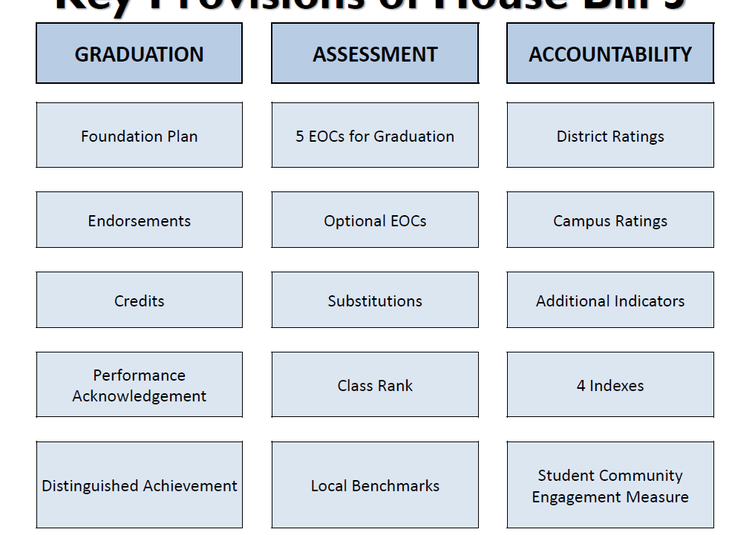
Key Provisions
Notes:
Student Achievement
Student Progress
Closing Performance Gaps
Post secondary
following indicators – percentages of students: earning business/industry certification/license, completing a coherent sequence of career and technical courses, completing dual credit courses or articulated postsecondary courses, achieving College Readiness Benchmarks or equivalent on the PSAT, SAT, ACT or ACT-Plan, and receiving college credit on an AP or IB exam. Also, the “Exemplary” and “Recognized” distinction designation labels are removed. 39.203 is limited to
129
academic achievement in English language arts, mathematics, science, and social studies. Distinction designations assigned by TEA in fine arts, physical education, 21st Century Workforce Development program, and second language acquisition are removed.

Slide 3
Fourth Mathematics Credit to earn an endorsement
Algebra II | IB Mathematical Studies SL
Precalculus | IB Mathematics SL
Advanced Quantitative Reasoning | IB Mathematics HL
Independent Study in Mathematics | IB Further Mathematics HL
Discrete Mathematics for Problem Solving | Engineering Mathematics
AP Statistics | Statistics and Risk Management
AP Calculus AB | Discrete Mathematics for Computer Science
AP Calculus BC | Locally developed math course or other activity [TEC 28.002 (g-1)]
AP Computer Science | Mathematics course endorsed by IHE [TEC 28.025(b-5)]
*Math Models (2014-2015 only) | College Prep Math [TEC 28.014]
Algebraic Reasoning (2015-2016) | Statistics (2015-2016)
Courses on this list can be taken before or after: Math Models, Math Apps in AFNR, Digital Electronics, Robotics Programming and Design

Slide 4
“Mathematics course endorsed by IHE”
If a school district determines that a student, on completion of grade 11, is unlikely to achieve the score requirement for one or more end-of-course assessment instruments administered to the student as provided for a high school diploma, the district shall require the student to enroll in a corresponding content-area college preparatory course for which an end-of-course assessment instrument has been adopted.
Scale scores to be developed by the commissioner

Slide 5
College Prep Math
Each school district in partnership with at least one IHE is to develop and provide courses in college prep for mathematics and English language arts for 12th grade students who do not meet the college readiness standards
  Provided on HS campus (distance learning option)
  Faculty from HS and IHE collaborate (Commissions of TEA and THECB may adopt rules)
  Must give notice to eligible students and their parents/guardians
  Successful completion of the course may be used for the advance ELA/Mathematics curriculum requirement
  Districts must develop or purchase instructional materials
  May be dual credit (at discretion of IHE)
  Must be available in 2014-2015
Notes:
Section 10
Note that a student who satisfies the TSI college readiness benchmarks also satisfy the EOC for that course and is not required to take the EOC.
A student who does not perform satisfactorily on the PSAT or the ACT-Plan is required to take the EOC
Pages 8-11 of enrolled version

