Slide 1
Bridging the Gaps: College Preparatory Courses in Region 3
Bridges to Success Summit
October 16 & 17, 2015
Victoria, TX
Notes:
Mary Harris introduce herself

Slide 2

1905 Leary Lane
Victoria Texas 77963
www.esc3.net
Nan Gainer
Cheryl Shamburger
Gayle Parenica
Ashley Bergeron
Mary Lea Pfenninger
Notes:
R3teams introduces ourselves

Slide 3
Goals of Presentation
1. Learn about the College Preparatory Courses mandated by HB 5 as developed in ESC Region 3
2. Experience perspectives of collaborators in building pathways for college readiness and success
3. Consider work in Region 3 from a broader perspective
http://untavatar.org
Notes:
Mary Lea

Slide 4
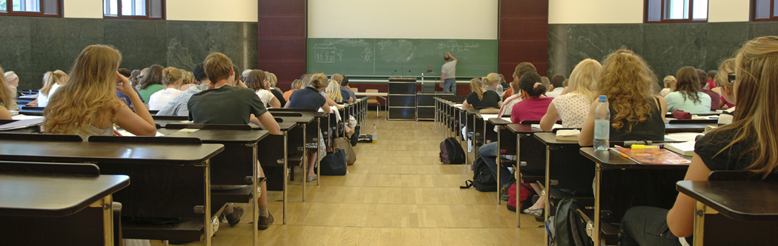
College Preparatory Courses in Region 3
Notes:
Cheryl Shamburger

Slide 5
College Preparatory Courses
Districts must partner with at least one IHE to develop college prep courses in math and ELA for 12th grade students who do not meet college readiness standards or whose performance indicates they are not ready for entry-level college coursework.
Effective 2013-2014 (with courses to be provided no later than 2014-2015)
High school and IHE faculty must meet regularly as necessary to ensure courses are aligned with college readiness expectations.
Notes:
Cheryl Shamburger
HB 5, Section 10 (TEC 28.014); LBB p. 115
Notes:
This is specific to mathematics and ELA courses.
Not meeting college readiness standards is automatically indicated if the student fails an EOC exam.

Slide 6

What is AVATAR (Academic Vertical Alignment Training and Renewal)?
Name (include yourself) | District/University/Workforce or P-16 Council | Title/Position |  | Phone
LaShonda Evans | Region 4 ESC | Education Specialist | lashonda.evans@esc4.net | 713-744-6380
June Giddings | GCPASS/Houston A+ Challenge | Director | jgiddings@houstonaplus.org | 713-658-1881
Cynthia Williams | Spring ISD | CTE Director | cynthiaw@springisd.org | 281-891-6200
Tiffany Rhodriquez | Spring ISD | Guidance & Counseling Director | trhodri@springisd.org | 281-891-6368
Beth Gilleland | Klein ISD | Student Support Services Officer | egilleland@kleinisd.net | 832-249-4319
Michelle McCharen | Klein ISD | College & Career Readiness Counselor | mmcharen@kleinisd.net | 281-467-3192
Brian Reeves | Lone Star University Park | English Department Chair | Brian.L.Reeves@lonestar.edu | 281-290-3749
Martha Donnelly | Lone Star University Park | Math Department Chair | Martha.E.Donnelly@lonestar.edu | 281-290-5053
Notes:
Mary Harris

Slide 7
What is AVATAR?
Academic Vertical Alignment Training and Renewal
First funded in 2011 by the Texas Higher Education Coordinating Board as part of its Closing the Gaps strategic plan
Facilitated by the University of North Texas for the North Texas Regional P-16 Council, which serves the Dallas Fort Worth area
Currently active in all 20 Education Service Center regions of the Texas Education Agency
http://untavatar.org
Notes:
Mary Harris

Slide 8
AVATAR Goals
Close gaps in student access to and success in post-secondary education through collaboration focused on
2011-14: Vertical alignment of the core curriculum
2014-15: Vertical alignment through College Preparatory Courses in ELA and mathematics designed for high school students who are not college ready and may, according to local agreement, exempt the TSI (a provision of HB 5, 2013)
2015-16: Vertical alignment of curriculum arising from endorsement options offered by local high schools and continuation of work begun in earlier years.
http://untavatar.org
Notes:
Mary Harris

Slide 9
Why alignment?
Too many secondary and postsecondary leaders and educators lack shared and accurate information and understanding of what a student must know and do to be successful in postsecondary education and careers;
Too many students enter postsecondary education but do not complete in a timely fashion; and
Too many students take developmental education at the postsecondary level.
http://untavatar.org
Notes:
Mary Harris

Slide 10
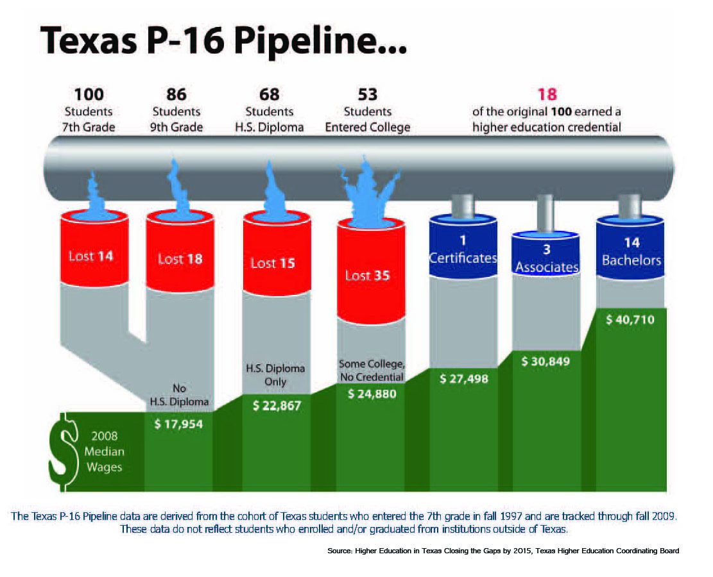
Notes:
Ashley

Slide 11
Source: Texas Higher Education Coordinating Board and Texas Education Agency. "Not found" graduates have standard ID numbers that were not found in the specified year at Texas higher education institutions. "Not trackable" graduates have non-standard ID numbers that will not find a match at Texas higher education institutions. Includes high schools with more than 25 graduates.
Notes:
Ashley

Slide 12
High Schools
2 Year IHEs
Scaffolding
Student
Success
4 Year IHEs
Regional ESCs
Regional P-16
Councils
AVATAR is a Partnership of Regional Leaders from these institutions
Notes:
Mary Harris

Slide 13
The AVATAR Process
Creates and builds relationships through ongoing critical conversations
Uses regional data to make alignment decisions
Develops shared understanding of college and career readiness and success for students
Identifies and implements intentional actions
Evaluates, sustains, and shares vertical alignment work
http://untavatar.org
Notes:
Mary Harris

Slide 14
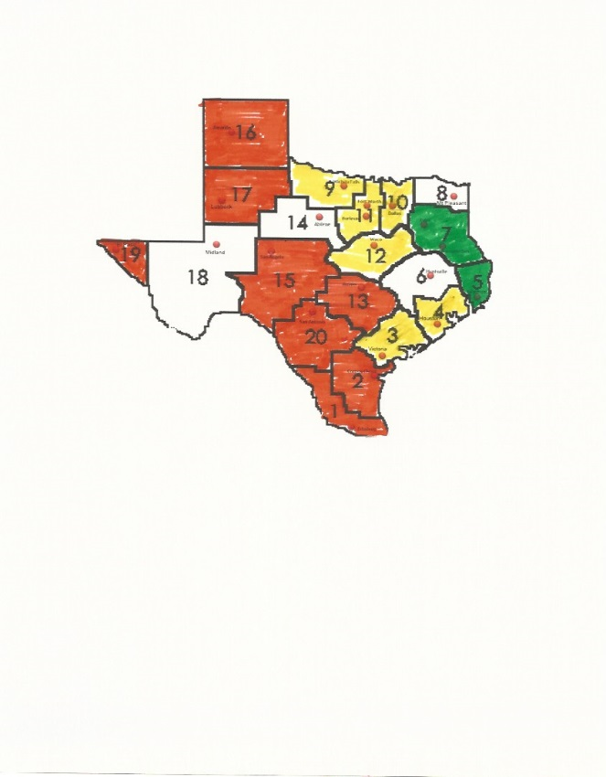
What was accomplished by Region 3 in 2014-2015?
Notes:
Nan Gainer

Slide 15
Region 3 Partnership
University Houston, Victoria
Coastal Bend community College
Victoria College
Wharton Jr. College
Industrial ISD
Ganado ISD
Karnes City ISD
Victoria ISD
Work Force Connection- Mike Rivet, Formosa

Slide 16
Core Meeting
December 2014
Initial contact
  What have you accomplished?
  How can R3 help you?
  How can we work together to help our LEAs and our R3 students?
Next Steps
  Recruit Schools for Partnership
  Recruit Businesses
Notes:
Nan Gainer

Slide 17
Vat Meetings 1
ELAR and Math VAT teams members
Core Group
  Broke into sub groups
    Established purpose
    Networking between colleges and high school faculty
    Examination of Region 3 Postsecondary Readiness Data
    Examination of College Career Readiness Standards
Notes:
Gayle Parenica

Slide 18
VAT Meeting 2
Representatives from colleges and high schools met to brainstorm expectations for 5 areas of common concern
  Setting expectations for college students
  Identifying gaps
  Differentiated learning
  Assessment
  Portfolio development
  Organization of courses
Notes:
Gayle Parenica

Slide 19
VAT Meeting 2 (cont’d)
Livebinder was created to house information about expectations, suggestions for format of coursework, and general resources
Participants learned how to upload information to the livebinder
Plans were made for committees to create training modules organized around concerns and resources for faculty involved in teaching courses
Notes:
Gayle P

Slide 20
Fall 2015 AVATAR
Expectations
Core Group meet with additional business partners
Begin discussions on alignment between HS courses, college courses, and business needs.
Hold ELA and Math VAT sessions to work on the development of the modules
Determine delivery methods and expectations for those attending sessions
Continue to add resources to livebinder
Notes:
Mary Lea

Slide 21
How CPC’s link to a national interest in transitions for high risk students
NUMBERS OF REGIONAL ACTIVITIES AND PARTICIPANTS, 2014-2015
By providing for College Preparatory Courses, Texas joins 37 other states that are exploring high school transitional courses as an alternative to developmental education (Barnett et al, 2013).
College Preparatory Courses support imperatives to to address student need for remediation at the lowest possible level, using fast-track models, and support brush-up before placement testing (Center for Community College Student Engagement, 2014; Office of President, 2014).
Center for Community College Student Engagement (2014). A Matter of Degree: Practices to Pathways. Austin TX: University of Texas at Austin, Higher Education Leadership.
Executive Office of the President (2014). Increasing College Opportunity for Low-Income Students. Washington D.C. : White House.
Barnett, E. A., Frey, M. P., Trimble, M. J., & Pheatt, L(2013). Reshaping the College Transition. Teachers College, Columbia University: Community College Research Center.
Notes:
Mary Harris

Slide 22
Texas success in transitional course implementation rests on
Leadership in standards based reform based on Texas College and Career Readiness Standards common to K-12 and higher education.
A common and progressive college readiness assessment in the TSI.
Liberalization of high school graduation requirements with opportunity for new courses.
A pattern of regional ESC’s and P-16 Councils
Demonstrated willingness to gear curriculum to address needs of vulnerable students
Notes:
Mary Harris

Slide 23
http://untavatar.org
Please visit the AVATAR website for more information.
Notes:
Mary Harris

Slide 24
Presenters
Nan Gainer, Region 3 Curriculum &Instructor Director
Cheryl Shamburger, Region 3 Career and Technical Education Specialist
Gayle Parenica, Region 3 C&I Accountability & Assessment Specialist
Ashley Bergeron, Region 3 Social Studies, EPP Specialist
Mary Lea Pfenninger, Region 3 Gifted/Talented, Advanced Academics, & AVATAR Specialist
Mary Harris, Professor Emerita, University of North Texas, Co-Convener, North Texas Regional P-16 Council, Denton, TX, mary.harris@unt.edu, 940 367-3026

