Slide 1
AVATAR Project Overview
Presented by: Education Service Center Region 11
January 23, 2014
http://www.ntp16.notlb.com/avatar

Slide 2
What is AVATAR?
Academic Vertical Alignment Training And Renewal
AVATAR is a statewide network, comprised of regional efforts, focused on vertical alignment to support students’ college and career readiness and success.
AVATAR is a Texas Higher Education Coordinating Board (THECB) funded project which is implemented by the North Texas Regional P-16 Council and the University of North Texas.

Slide 3
Who is AVATAR?
A Partnership of Regional Leaders From…
High Schools
2 Year IHEs
Scaffolding
Student
Success
4 Year IHEs
Regional ESCs
Regional P-16
Councils
Working to Scaffold Student Success

Slide 4

AVATAR: Statewide Vertical Alignment Network Comprised of Regional Partnerships

Slide 5
The AVATAR Project Outcomes
What are AVATAR’s Goals?
Expand awareness of and create regional vertical alignment initiatives to prepare and support students who are college and career ready and successful
Identify and implement strategies to close regional course and expectation gaps
Identify processes to assess and celebrate regional progress in preparing college and career readied students
Share best practices statewide

Slide 6
Why Do We Need AVATAR?
Too many secondary and postsecondary leaders and educators do not have shared and accurate information and understanding of what a student needs to know and do to be successful in postsecondary education and career;
Too many students enter postsecondary education and do not complete in a timely fashion; and
Too many students take developmental education at the postsecondary level.

Slide 7

Workforce Needs
Around 50% of jobs in Texas are middle-skill but only about 40% of those workers have the appropriate training.
80% of jobs in the state of Texas are middle-or high-skill and require some postsecondary education. This percentage is estimated to remain the same through 2018.
Source: Texas Workforce Commission cited in Texas Middle-Skill Jobs from National Skills Coalition
Retrieved From: http://www.nationalskillscoalition.org/pdf.html?file=http://www.nationalskillscoalition.org/resources/fact-sheets/state-fact-sheets/middle-skill/nsc_middleskillfs_texas.pdf

Slide 8
Educational Attainment
Texas
79.9%
25.5%
National Average
85.3%
27.9%
10.3%
8.5%
High School Graduate or more, In Percent
Bachelor’s Degree or more, in percent
Advanced Degree or more, in percent
From: U.S Census Bureau, 2009
http://www.census.gov/compendia/statab/cats/education.html

Slide 9
Closing the Gaps by 2015
In 2000, the Texas Higher Education Coordinating Board began an initiative to close the gaps of educational attainment in Texas and between Texas and other states in the areas of:
  Student Participation
  Student Success
  Student Excellence
  Student Research
Retrieved from: http://www.thecb.state.tx.us/index.cfm?objectid=858D2E7C-F5C8-97E9-0CDEB3037C1C2CA3

Slide 10
Closing the Gaps Progress
Participation:
  Although statewide and African American participation is well above targeted levels, Latino and White participation is still well below.
Success:
  Through measurement of BACs (Bachelor’s, Associate’s, and certifications), student success is measured.
  Statewide BACs, Bachelor’s degrees, Associate’s degrees, Doctoral degrees, and allied health & nursing BACs are all above targeted levels. Latino BACs are on target but African American BACs, Technology BACs, teachers initially certified, and math & science teachers initially certified are all below targeted levels.
Excellence:
  National rankings are well below target but program recognition is on target.
Research:
  Although public institutions’ research expenditures are well above target, federal science & engineering research and development obligations are still below targeted levels.
Source: Closing the Gaps Progress Report, 2012
Retrieved from: http://www.thecb.state.tx.us/index.cfm?objectid=858D2E7C-F5C8-97E9-0CDEB3037C1C2CA3

Slide 11
Texas Population with Associate Degree or Higher
Report of The Select Commission on Higher Education and Global Competitiveness, January 2009

Slide 12
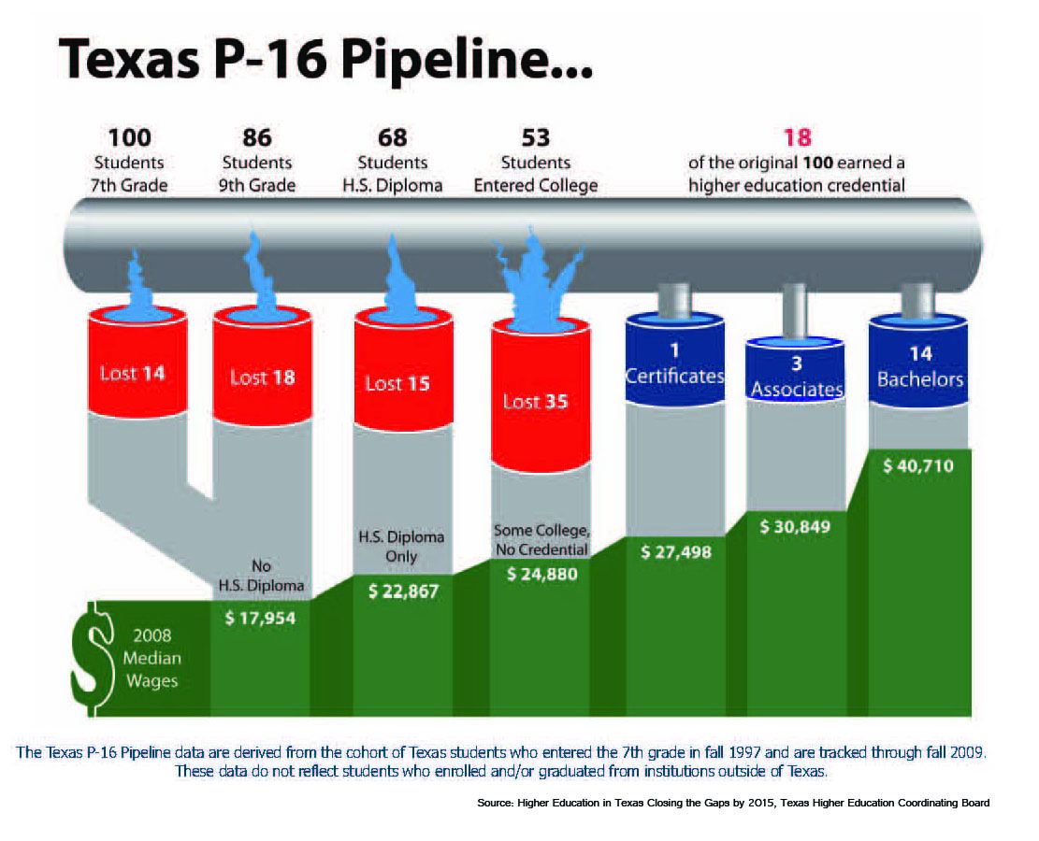
Texas P-16 Pipeline

Slide 13
Add THCEB Figure 3
Median Annual Wage
by Education Projected 2022
Source: Employment Projections Program, U.S. Department of Labor, U.S. Bureau of Labor Statistics http://www.bls.gov/emp/ep_table_education_summary.htm

Slide 14
Retention Rates Lower Each Year
Source: Complete College America/Alliance of the States 2011 Texas Report
Retrieved from: http://www.completecollege.org/state_data/

Slide 15
Barriers to Going Back to School (%)
Source: Public Agenda (2009). With Their Whole Lives Ahead of Them: Myths and Realities About Why So Many Students Fail to Finish College. Public Agenda. http://www.publicagenda.org/files/theirwholelivesaheadofthem.pdf

Slide 16
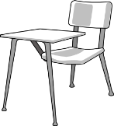
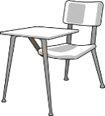
Too Many College Freshman Need Remediation
51% of those entering a
2-year college enrolled in remediation.
Of those students…
30% completed the remediation
14.3% completed the remediation and associated college-level courses in 2 years
5.8% Graduated within three years
22.5% of those entering a 4-year college enrolled in remediation.
Of those students…
49.2% completed the remediation
32.1% completed the remediation and associated college-level courses in 2 years
29.6% Graduated within six years
Source: Complete College America/Alliance of the States 2011 Texas State Remediation Report
Retrieved from: http://www.completecollege.org/state_data/

Slide 17
The Prevalence of Developmental Education
National statistics show that 40% of students that are admitted and enrolled at the post-secondary level take at least one developmental course.
17% of students that take one remedial reading course complete their degree.
20% of students that take two or more developmental courses complete their degree.
Students that take remedial courses:
Take longer to complete their degree
Are less likely to complete their degree
Source: National Center for Education Statistics, 2004

Slide 18

What do you know now that you didn’t know before?

Slide 19
Texas P-16 Pipeline
Vertical Alignment is a Process
Creates and builds relationships with ongoing critical conversations
Uses regional data to make alignment decisions
Develops shared understanding of college and career readiness and success for students
Reviews reference course profile information
Identifies and implements intentional actions
Evaluates, sustains, and shares vertical alignment work

Slide 20
AVATAR Partners & Team Members Roles
Partnerships: Leaders and educators representing regional independent school districts, two- and four-year institutions of higher education, P-16 councils, and education service centers committed to vertical alignment to support students’ college and career readiness and success.
Teams: Educators and leaders representing regional independent school districts, two- and four-year institutions of higher education, P-16 councils, and education service centers committed to addressing discipline specific course and instructional alignment needs to create environments where students can successful transitions between and among regional educational systems.

Slide 21
Partnership Benefits
Partnership Benefits
THECB: where is the partnership building?
  Build capacity to improve curriculum alignment between regional secondary and postsecondary courses
  Strengthen regional secondary and postsecondary commitment to college preparedness and success for students

Slide 22
AVATAR Partners and Team Members…
Are committed to higher education access and success for all students
Understand content knowledge and skills
Utilize research-based instructional strategies
Demonstrate strong communication and leadership skills
Are effective team players
Are flexible – able to deal with ambiguity

Slide 23
AVATAR Partners
Roles and Responsibilities
P-16 Council
  Provide regional college and career readiness student data and prepare the regional data PowerPoint
  Serve as the point of contact with the Texas Higher Education Coordinating Board (THECB) for the regional vertical alignment team and partnership

Slide 24
AVATAR Partners
Roles and Responsibilities
Independent School District (ISD)
  Identify campus or district leaders to participate and support vertical alignment partnership and team
  Identify and support discipline specific teachers and leaders to participate in the vertical alignment process
  Review and provide implementation support based on the VAT’s work

Slide 25
AVATAR Partners
Roles and Responsibilities
Postsecondary Education: Two- and Four-Year Institutions of Higher Education
General/Core Education Leaders and Faculty
  Identify campus, system, or district level leaders who are responsible for core or general education courses to participate and support the vertical alignment partnership and team
  Identify and support discipline specific faculty and leaders to participate in the vertical alignment process
  Review course syllabi and explore shared reference course profiles based on the VAT’s work

Slide 26
ESC Region 11
2014 AVATAR Project Goals
Convene a secondary and postsecondary vertical alignment team (Burleson ISD, Godley ISD, Joshua ISD, Hill College, and Tarleton University)
Expand or create a regional shared college and career readiness foundation/understanding among the partnership and team members
Provide time for vertical alignment critical conversations
Use regional data to guide decision-making
Create a collaborative document outlining writing non-negotiables, classroom strategies and evaluation tools to increase writing support in CTE classrooms

Slide 27
Critical Conversations
Secondary
Post-Secondary
Graduate College/Career Ready
Graduate Career Ready
Student Success Assessments
Dual Credit, Early College High Schools
Student Support Services
Educational Policies and Practices
Classroom Instruction, Textbooks,
Grading, etc.
Discipline Specific Course
Curriculum
Texas Essential Knowledge
and Skills
Impact of Developmental Education and
Texas Success Initiative
Dual Credit, Early College High Schools
Student Support Services
Educational Policies and Practices
Classroom Instruction, Textbooks
Grading, etc.
Discipline Reference Course
Profiles
College & Career Readiness
Standards

Slide 28
Partners for Success
Counselors
Community
Campus Staff
Students
Parents
Administrators
Teachers
Notes:
Read: Students need a circle of caring to achieve success. Who are these partners for success?
Counselors
Teachers
Administrators, especially the principal
Other campus staff (specialists, school psychologists, nurses, special education staff)
Parents
Community and business leaders - recruit individuals who can influence and hold the confidence of the school decision makers
These partners can form a steering committee and sounding board to assist a district/campus in:
Guiding efforts to create a culture of college and career readiness
Reviewing results of needs assessments
Making recommendations for program development
Reviewing accountability data and outcomes research
Locating internal and external funding sources
Remember, it takes a village, a community to raise a child.

Slide 29
AVATAR Outcomes
Identify key leaders and educators who make up a regional “pipeline” needed for students to be college and career ready and successful
Establish shared regional college and career readiness foundation/understandings
Use regional data to guide decision-making
Design and implement a vertical alignment action plan which will include critical conversations
Design and implement a sustainability plan

Slide 30
Team Members Meeting Norms
Norms encourage behaviors that will help a group do its work and discourage behaviors that interfere with a group’s effectiveness.
“Never doubt that a small group of thoughtful,
committed people can change the world.”
Margaret Meade

Slide 31
What are Norms?
Standards or expectations by which individuals or a group has agreed to operate while working together
Maximizes team productivity and effectiveness
Ensures individuals are respected
Places responsibility on individuals for expected behavior to build group community

Slide 32
Group Norms
Be respectful when others are voicing an opinion
Participate actively
  Ask questions
  Share experiences and insights
  Make connections
  Help each other
Tame the technology
Look at the data before making decisions

Slide 33

List three things you want others to know about your college education journey.
(Be prepared to share with a partner.)
Notes:
StandUp-HandUp-PairUp
Participants stand-up, put their hands up, and quickly find a partner to share one thing you want others to know

Slide 34
State, Regional, District, and
Higher Education Data
STAAR Writing Performance by Grade Level
STAAR Writing Performance All Grades
High School Indicators
  Annual Dropout Rate
  4-Year Longitudinal Rate
  RHSP/DAP Graduates
  Advanced Course/Dual Enrollment
Texas Success Initiative (TSI)
  English Language Arts
  College-Ready Graduates ELA Class
  AP/IB Tested 2012
  SAT/ACT Results
  Graduates Enrolled in TX Institution of Higher Education
  Graduates in TX IHE Completing One Year Without Remediation
SAT Scores
ACT Scores
Texas High School Graduates Enrolled in Higher Education Fall 2012
Online Resume for Hill College
Online Resume for Tarleton Sate University
Carl Perkins Performance Measures

Slide 35
Data Discussion
Form 8 groups of 3 participants
Each group will examine assigned data set
Be prepared to chart and whole group discuss the following:
  What patterns and trends do you see?
  How does this data inform college and career student success?
  How will you share this data?
  What do you still want to know?

Slide 36
House Bill 5
Update

Slide 37

Working Lunch Discussion
(A Complete Definition of College and Career Readiness)
I used to think……………..
and now I think……………..

Slide 38
Texas Success Initiative Overview
Statewide postsecondary college ready assessment instrument
Replaced the ACCUPLACER assessment instrument

Slide 39
College and Career Readiness Standards (CCRS)
Overview

Slide 40
Next Steps
Project Focus
  Create a collaborative document outlining writing outcomes (aligned to ELA and CTE TEKS and CCRS), classroom strategies and evaluation tools to increase writing in CTE classrooms
Meeting dates and time
  January 23, 2014
  February 10, 2-14
  March 2014 (TBA)
Questions and/or Concerns

Slide 41
Session Reflection
What did you learn today that you can share with others?
What do you still want to know?

Slide 42
ESC Region 11 AVATAR Contacts
Kathy Wright-Chapman
Director of
Research, Planning, Assessment, and Evaluation
kwc@esc11.net
817-740-7546
Susan Patterson, CTE Consultant
spatterson@esc11.net
817-740-7754

